Slide 1

Car Sales Dashboard Overview
This presentation highlights key car sales metrics using Tableau.
Explore sales trends, pricing, and vehicle volumes to gauge performance.

Slide 2
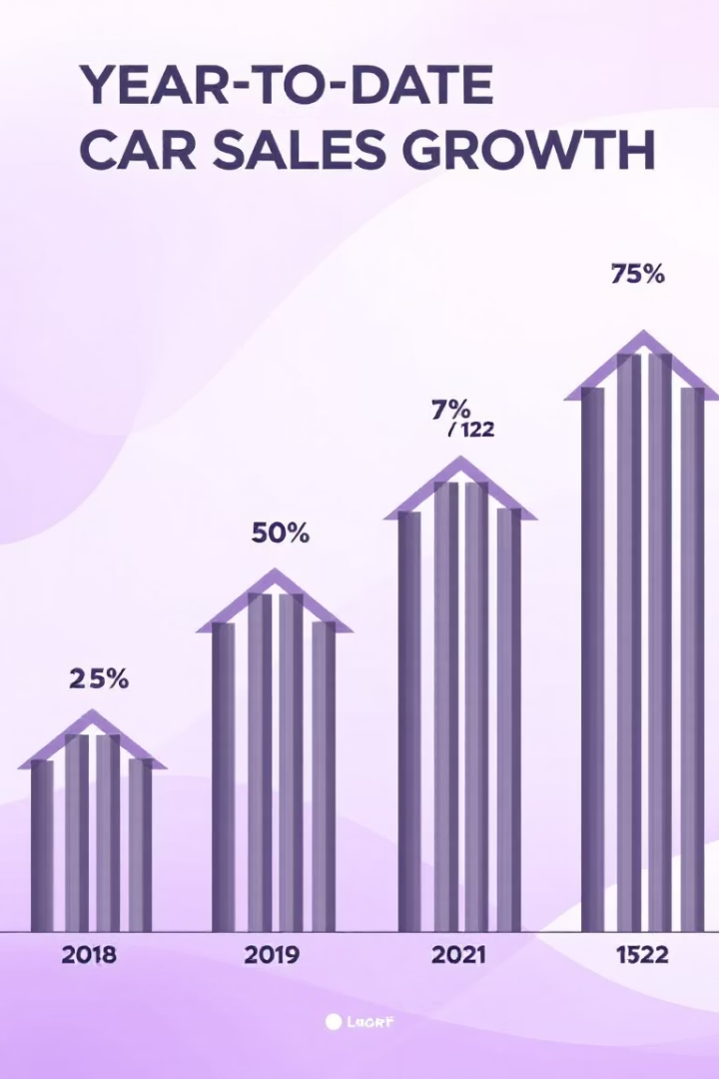
Sales Overview
Year-to-Date Total Sales
Robust total sales achieved so far, reflecting market demand.
Year-over-Year Growth in Sales
Sales increased significantly compared to the previous year.

Slide 3

Average Price Analysis
YTD Average Price
Average car price indicates premium segments gaining popularity.
YOY Growth in Average Price
Steady price increase driven by new model launches.

Slide 4
Cars Sold Metrics
YTD Cars Sold
YOY Growth in Cars Sold
Strong vehicle sales volume supports company targets.
Marked increase in units sold compared to last year.

Slide 5
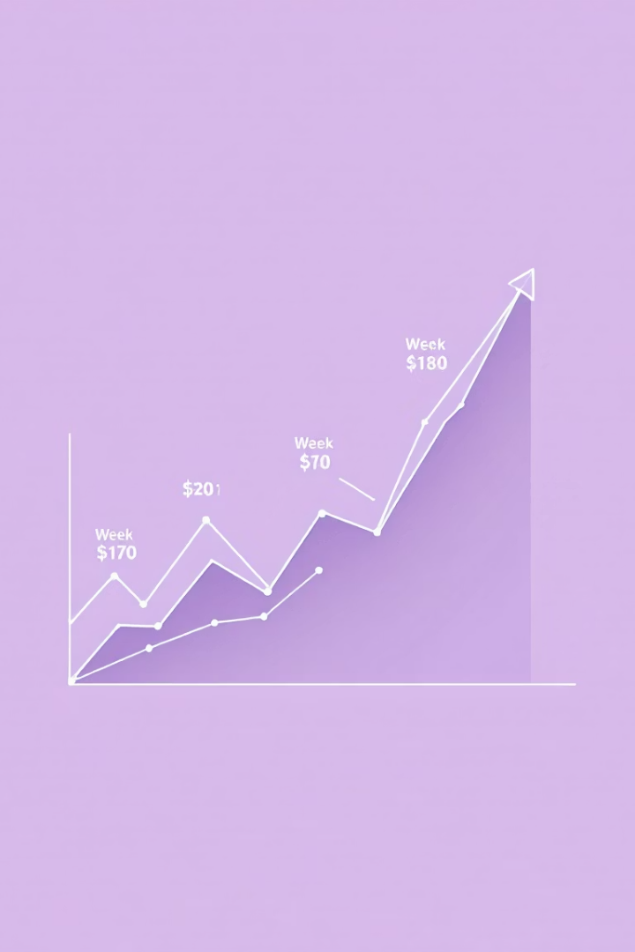
YTD Sales Weekly Trend
Weekly Sales Fluctuations
Smooth upward trend with seasonal peaks and troughs.
Analysis of Weekly Performance
Insights help optimize promotions and inventory.

Slide 6



Comparative YOY Sales Growth
Growth Drivers
2
Promotions and market demand key growth influences.
Seasonal Peaks
Major spikes in sales during holiday and new model launches.
1
Challenges
3
Economic factors create occasional slowdowns.

Slide 7
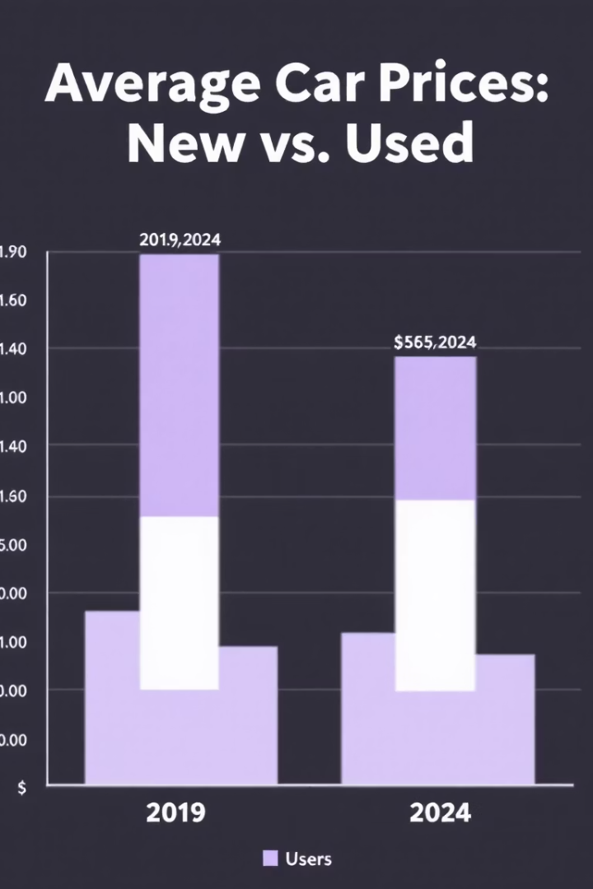
Price Trends by Car Category
1
Economy
Stable moderate pricing with slight growth.
2
SUVs
Significant price increase reflecting demand.
3
Luxury
Highest price growth driven by premium features.

Slide 8




Key Takeaways & Next Steps
Monitor Weekly Sales Closely
Adjust inventory and promotions dynamically.
Leverage Pricing Insights
Focus on profitable segments and growth categories.
Plan for Seasonal Demand
Prepare campaigns aligned with sales peaks.

